Slide 1
Knight’s Travails (A BFS Algorithm implementation)
By: Jean Luka Molina
8/5/2022
Advanced Data Structures

Slide 2

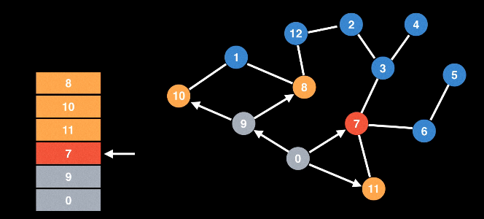
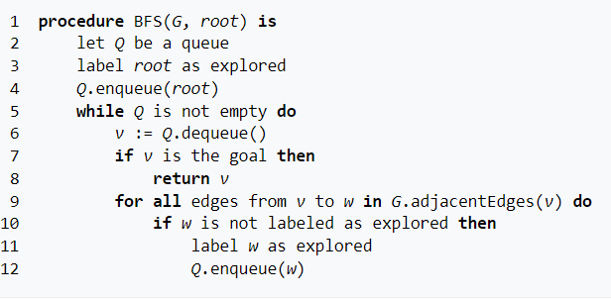
What is BFS and how does it work
Stands for Breadth First Search Algorithm
Previously seen in Data Structures
Start at an arbitrary Node and explore its neighbors, then move to the next level of neighbors
Keep track of already visited nodes

Slide 3
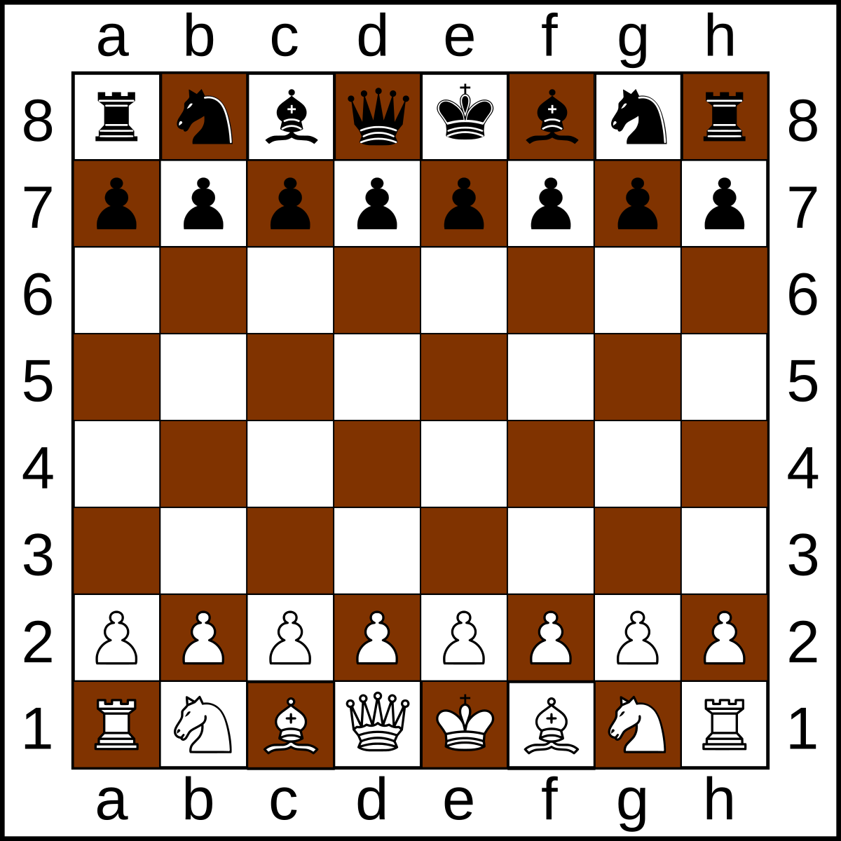
Knight’s Travails Goal
Create an 8x8 board to place the night
Set a starting and ending point
Find shortest path between those two with only being able to move the same way a knight does (L)

Slide 4
Overview of my Classes
3 Main Classes and a test class:
BFS
Knight
Board

Slide 5
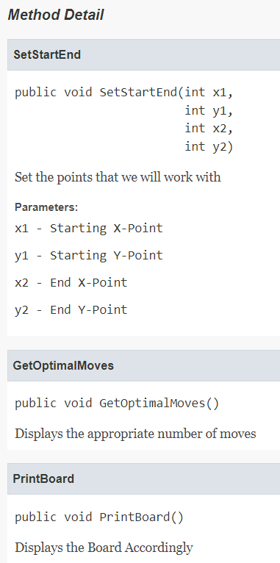
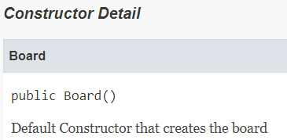
Board

Slide 6
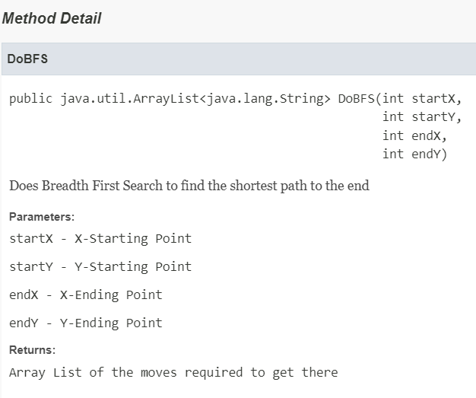
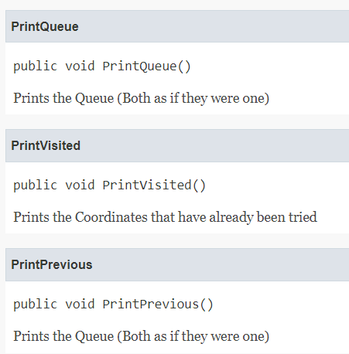
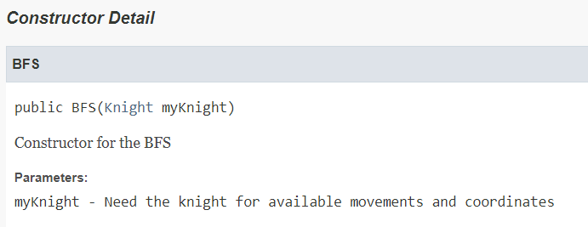
BFS

Slide 7
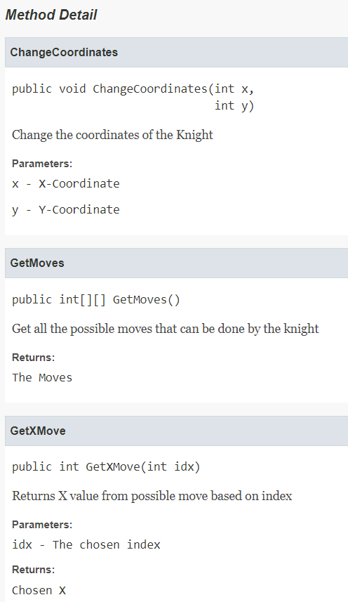
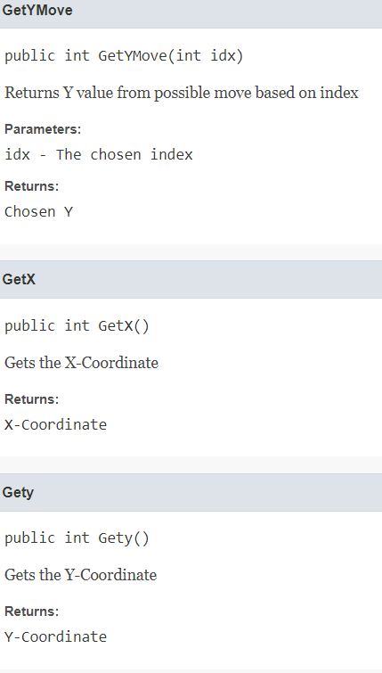
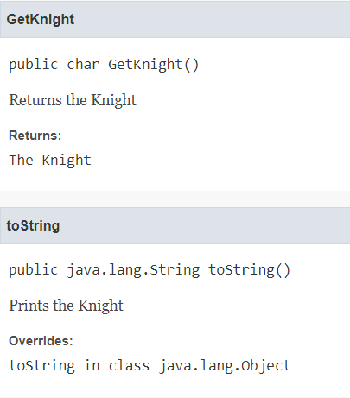
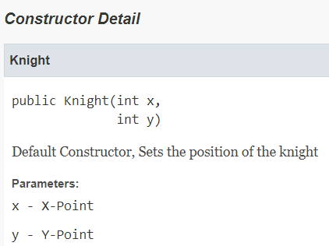
Knight

Slide 8
Sources
https://www.youtube.com/watch?v=oDqjPvD54Ss&t=299s
https://en.wikipedia.org/wiki/Breadth-first_search

